Slide 1
US Birth by Year, State and Education
File created on: 5/7/2025 8:58:01 PM

Slide 2


Slide 3
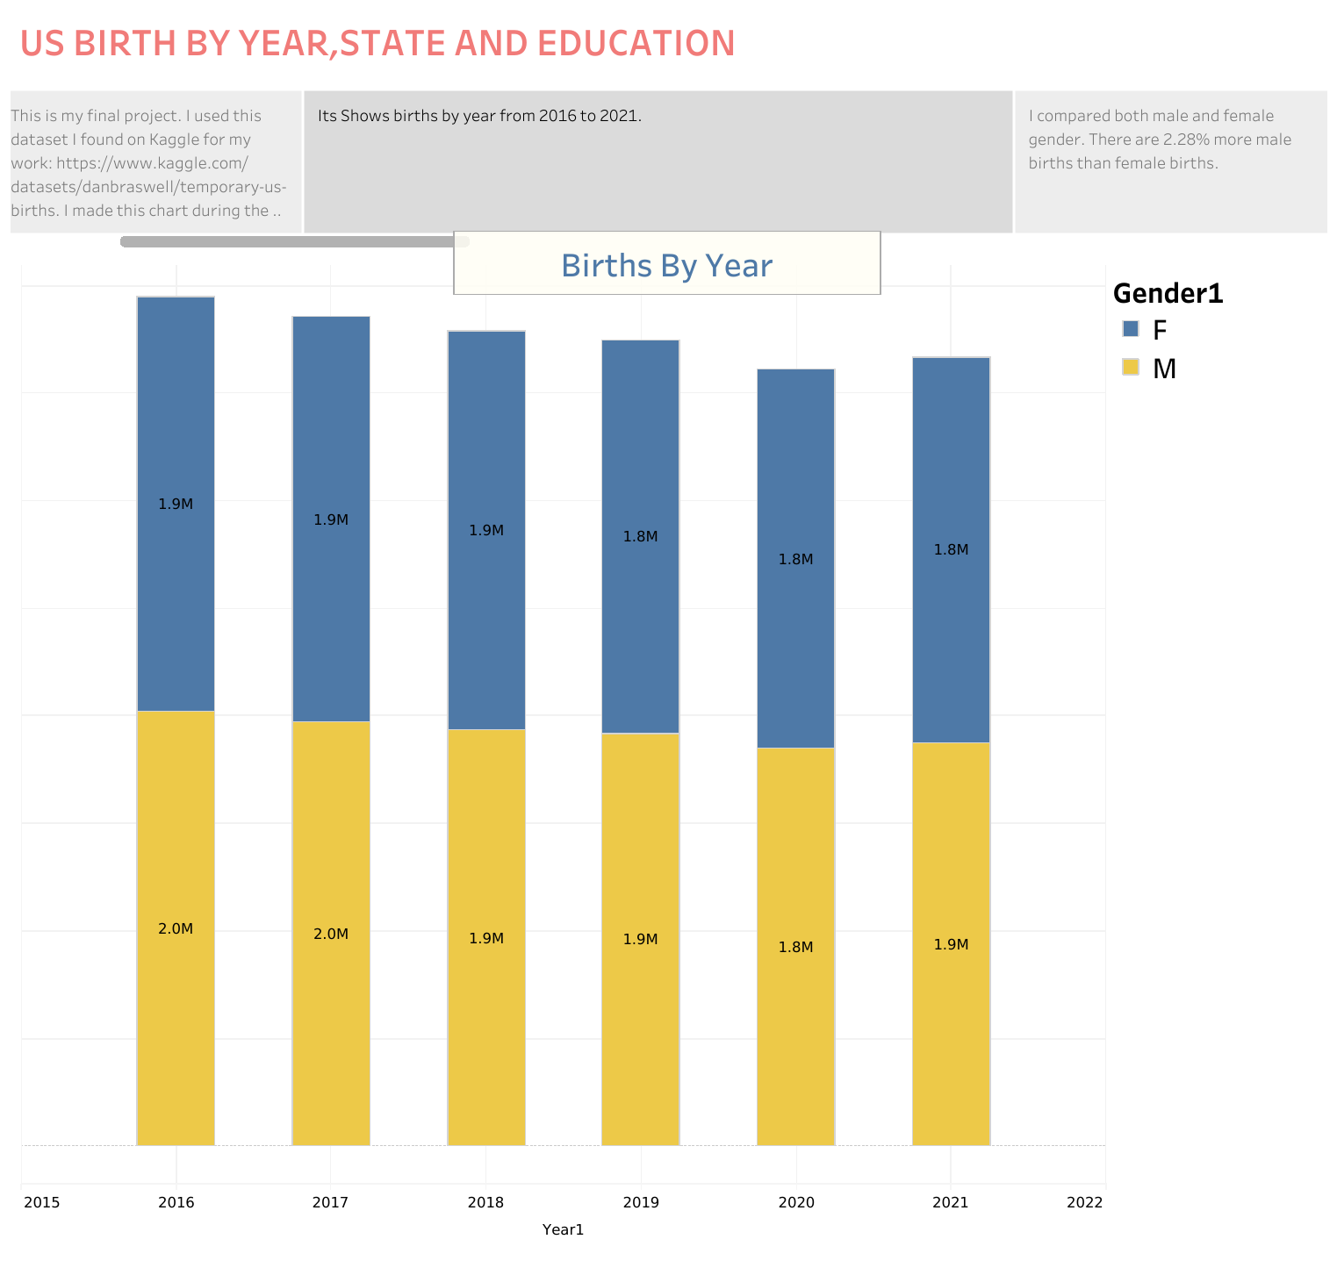

Slide 4
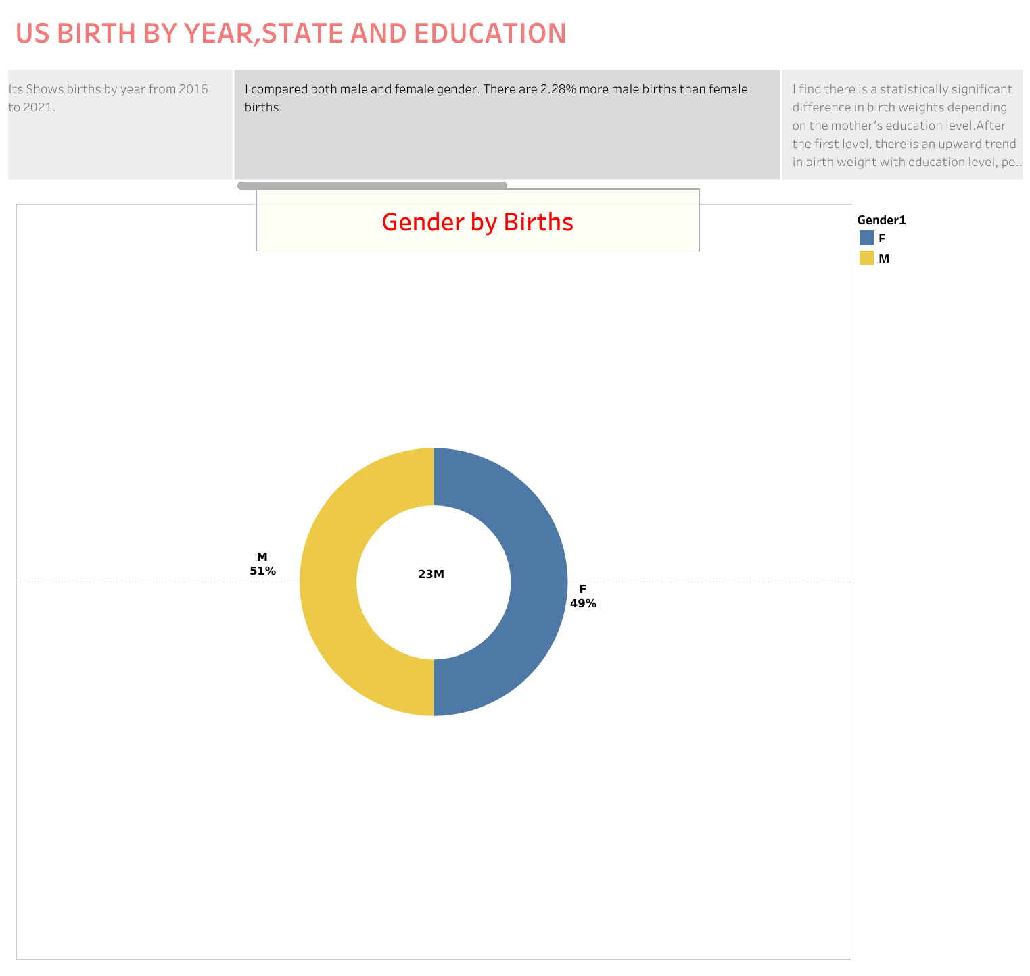

Slide 5
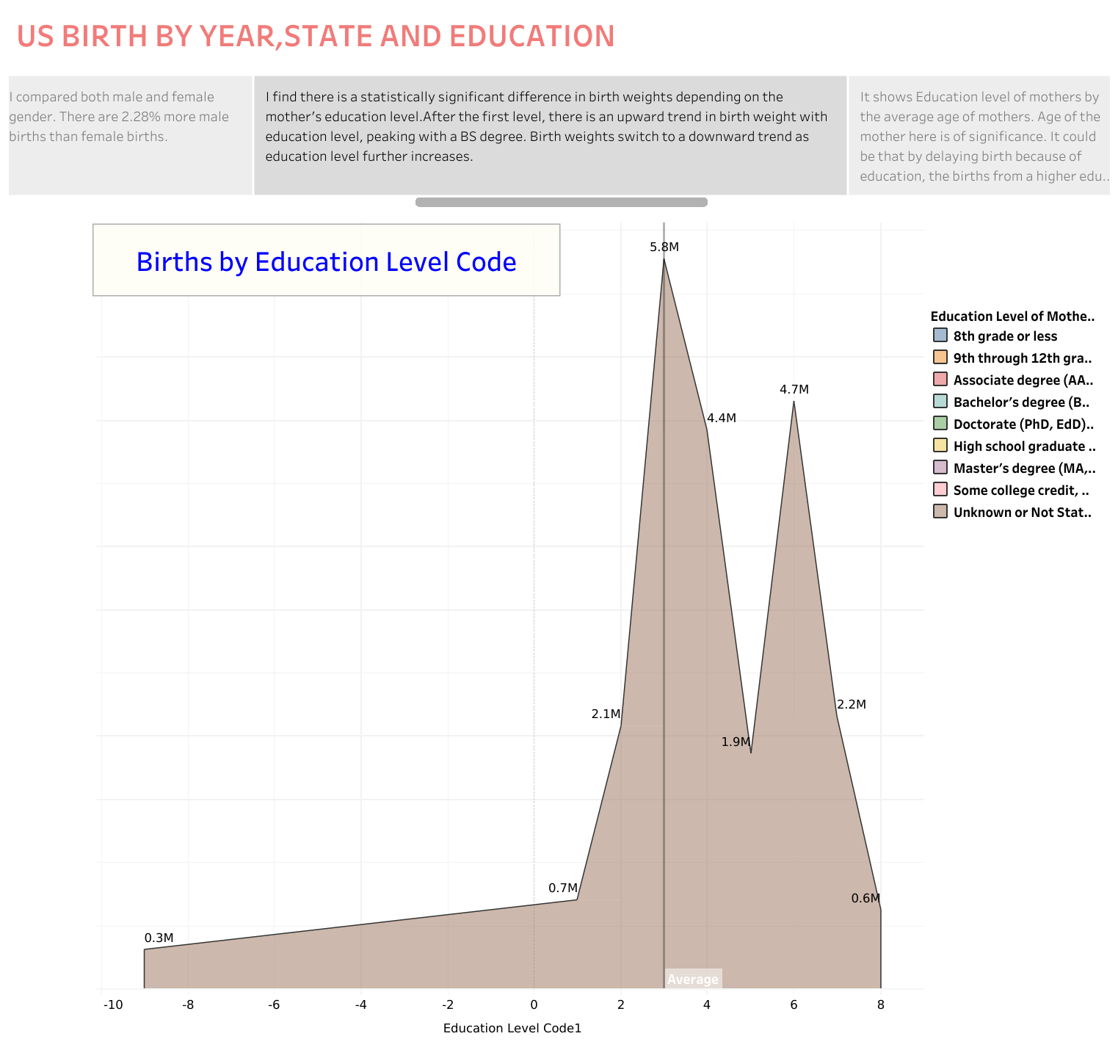

Slide 6
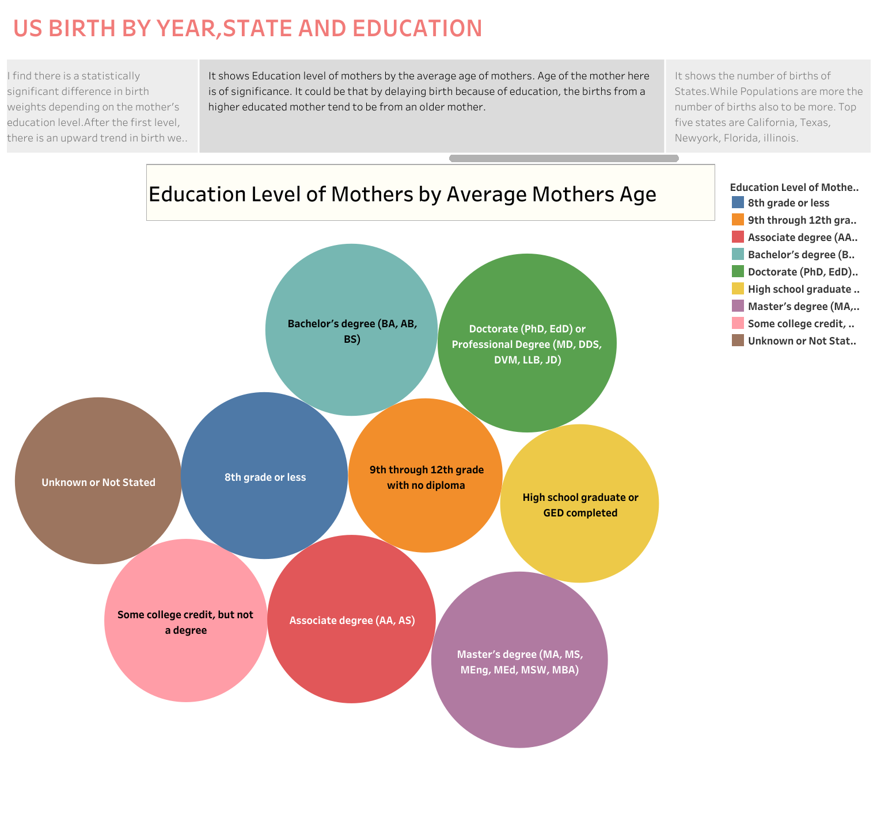

Slide 7
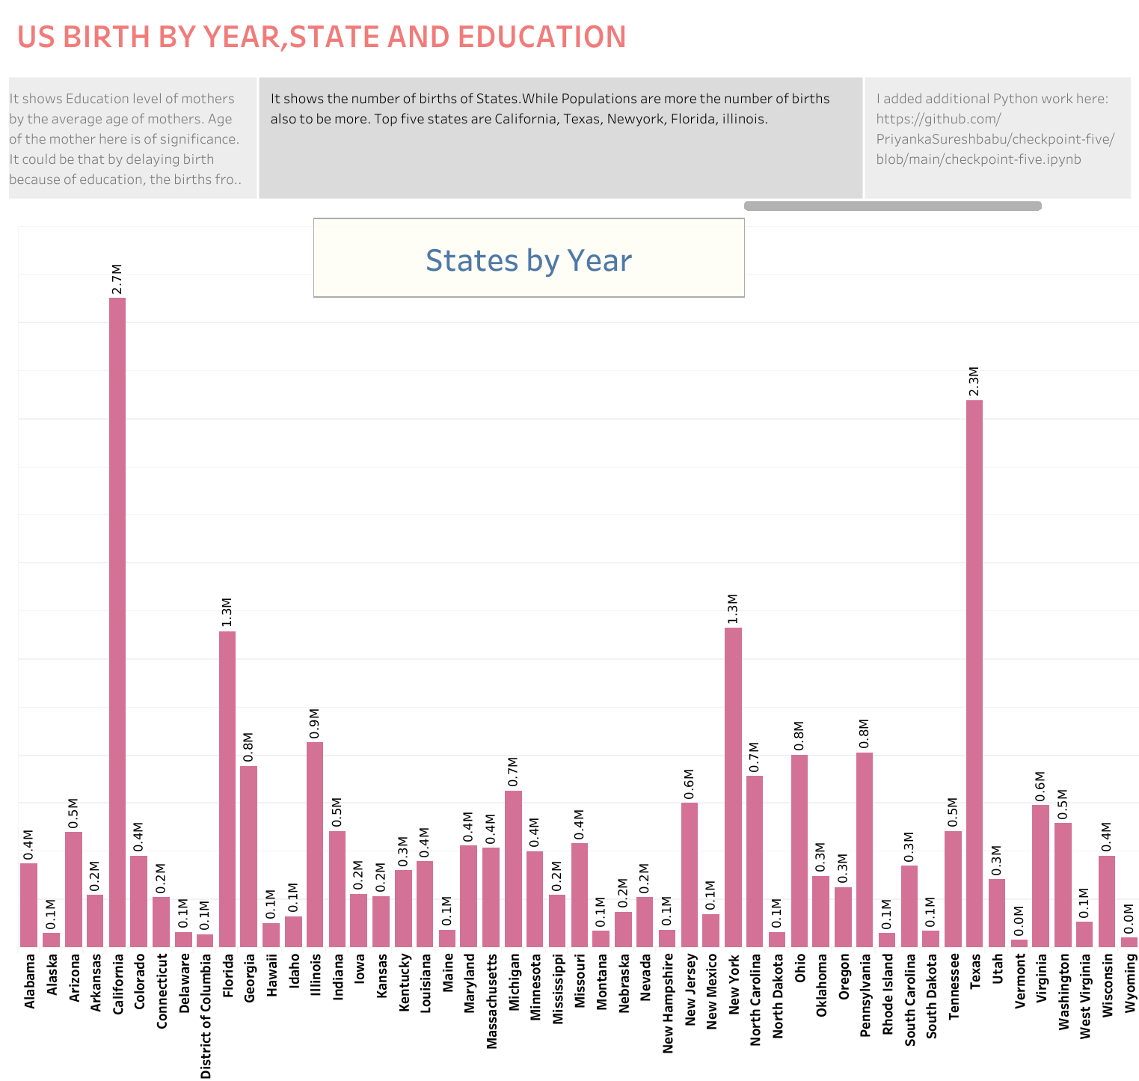

Slide 8
